Slide 1
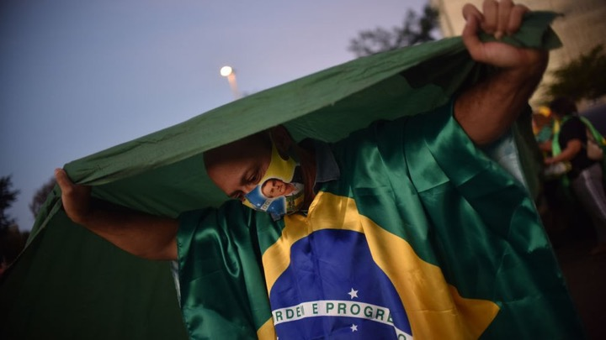
How COVID-19 Played out In Brazil

Slide 2
Storyline
How is the overall situation?
Which state has the worst scenario?
Clustering Cases per City
1
3
5
Why is the situation in São Paulo so bad?
2
How did it start?
4

Slide 3
“It is not an alarming situation”
Jair Bolsonaro, President of Brazil
174,515
Brazil is the third worst country according to the number of cases
Deaths
6,436,650
Cases

Slide 4
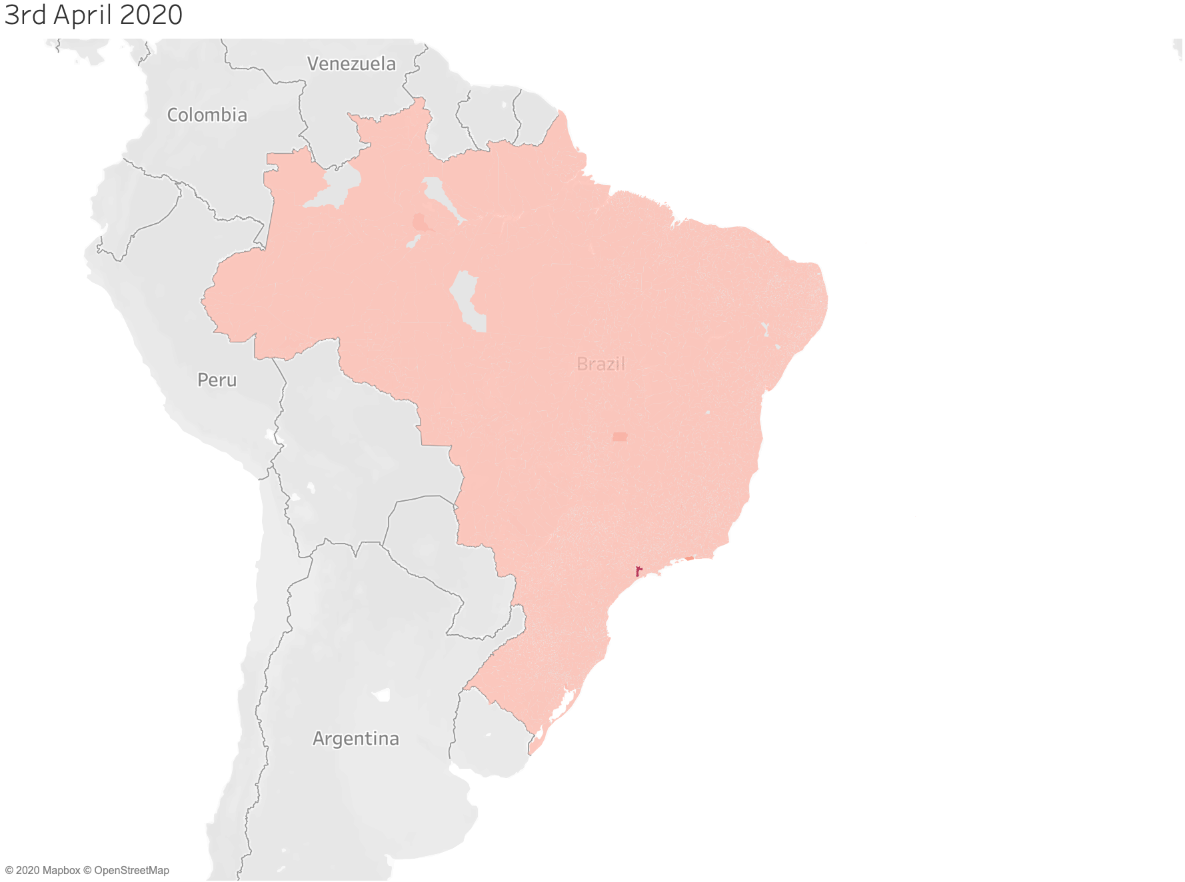
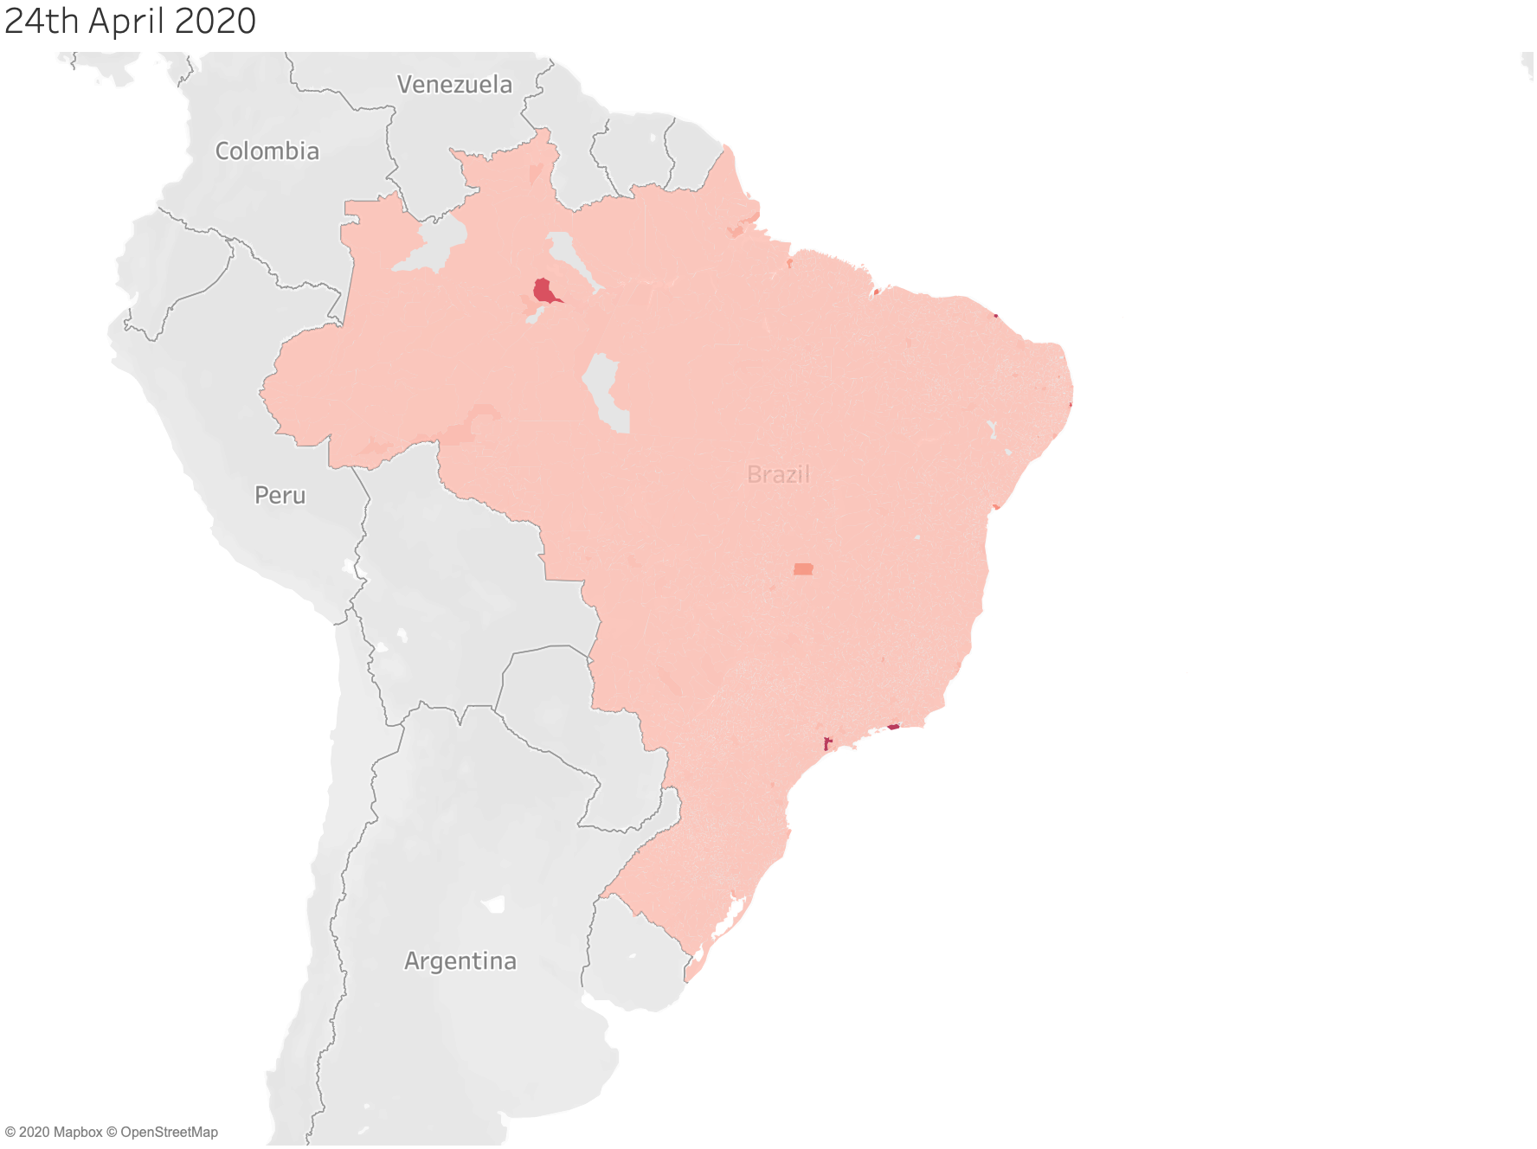
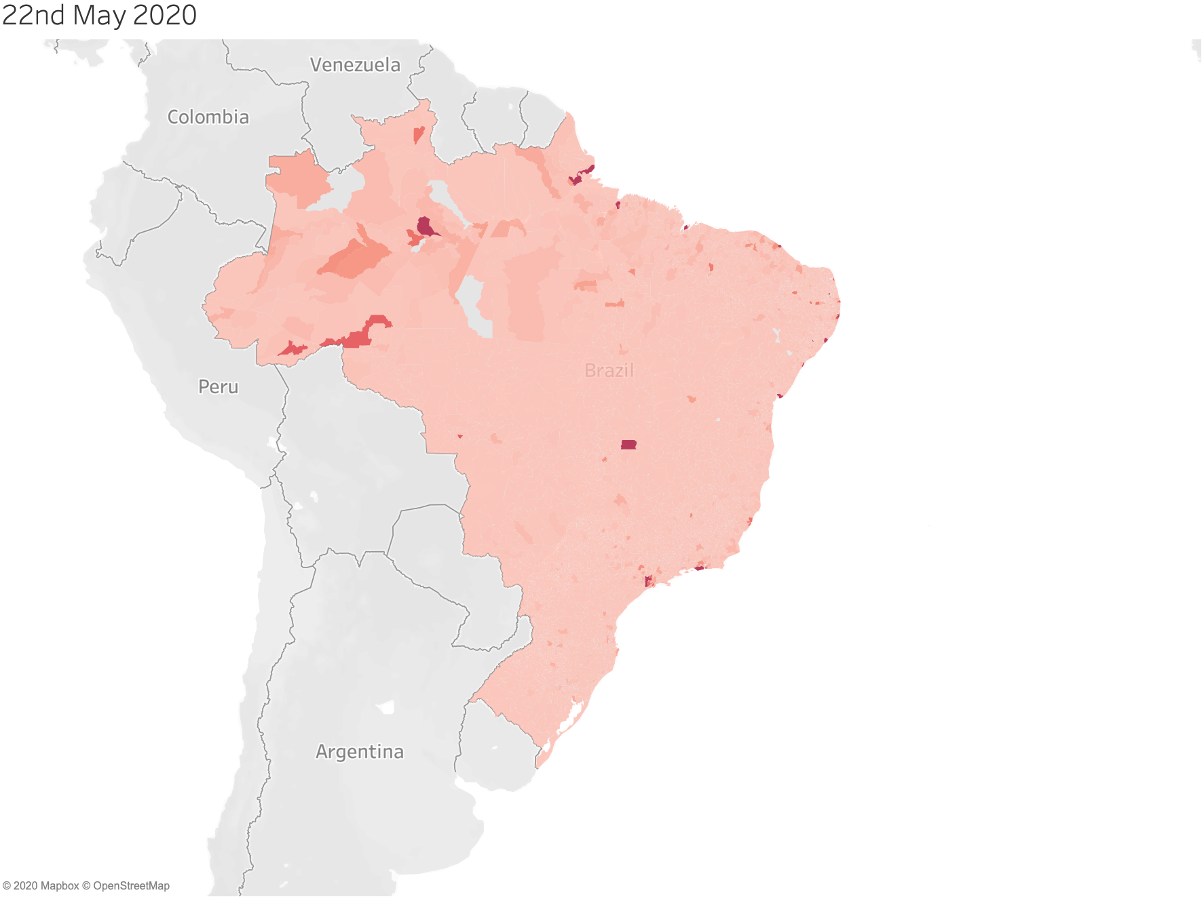
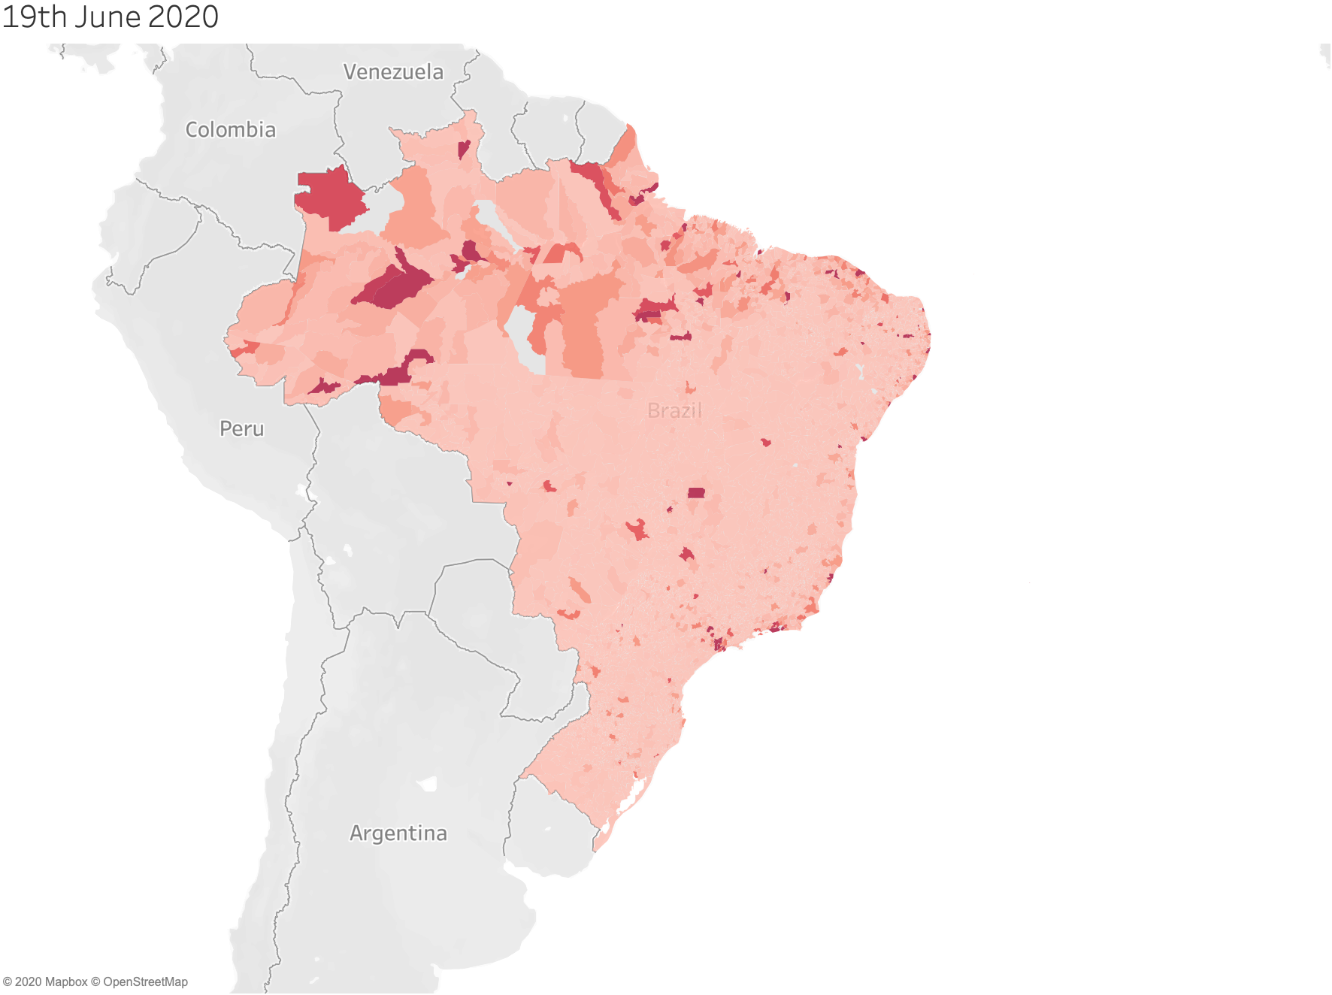
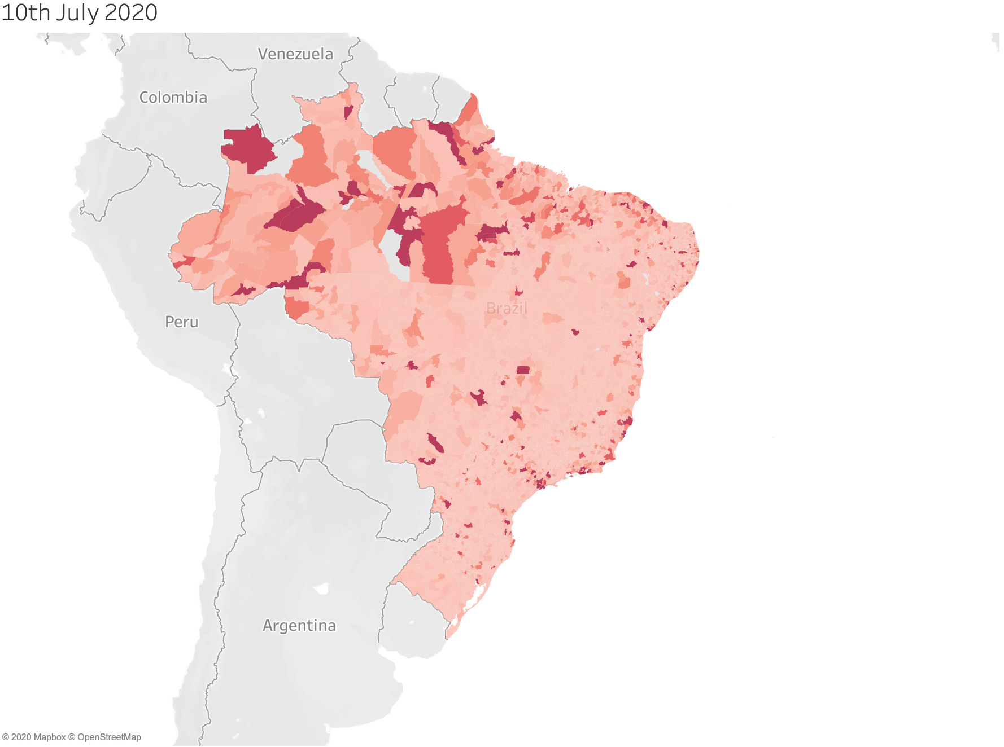
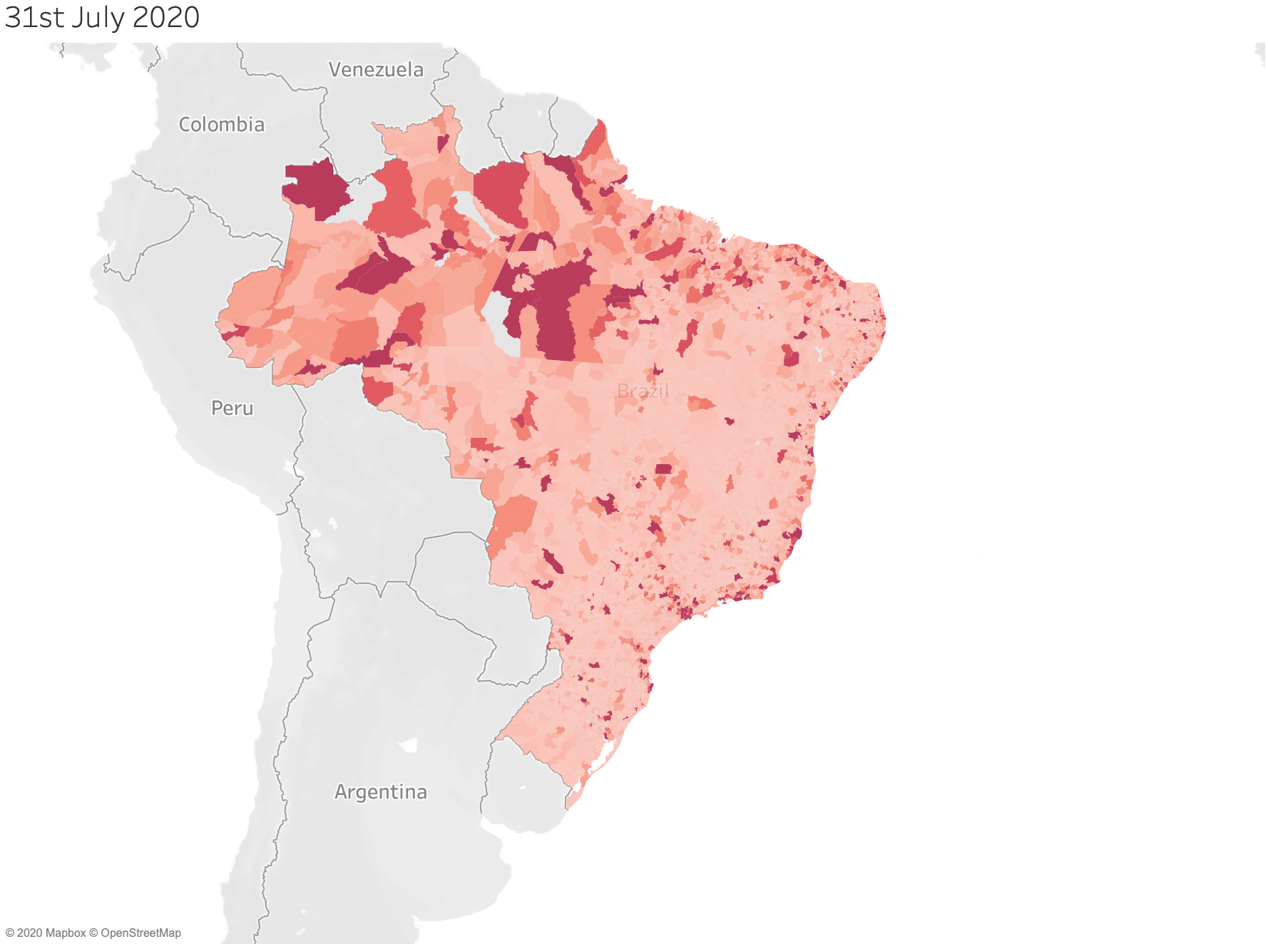
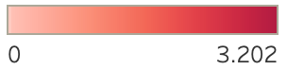
How did it start?
Cases per 100k

Slide 5
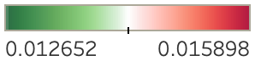
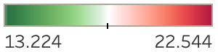
The South had highest Mortality...
Mortality per 100k
Cases per 100k

Slide 6
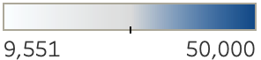
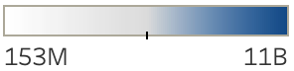
.. while having high GDP & Population
GDP per Capita
Population

Slide 7
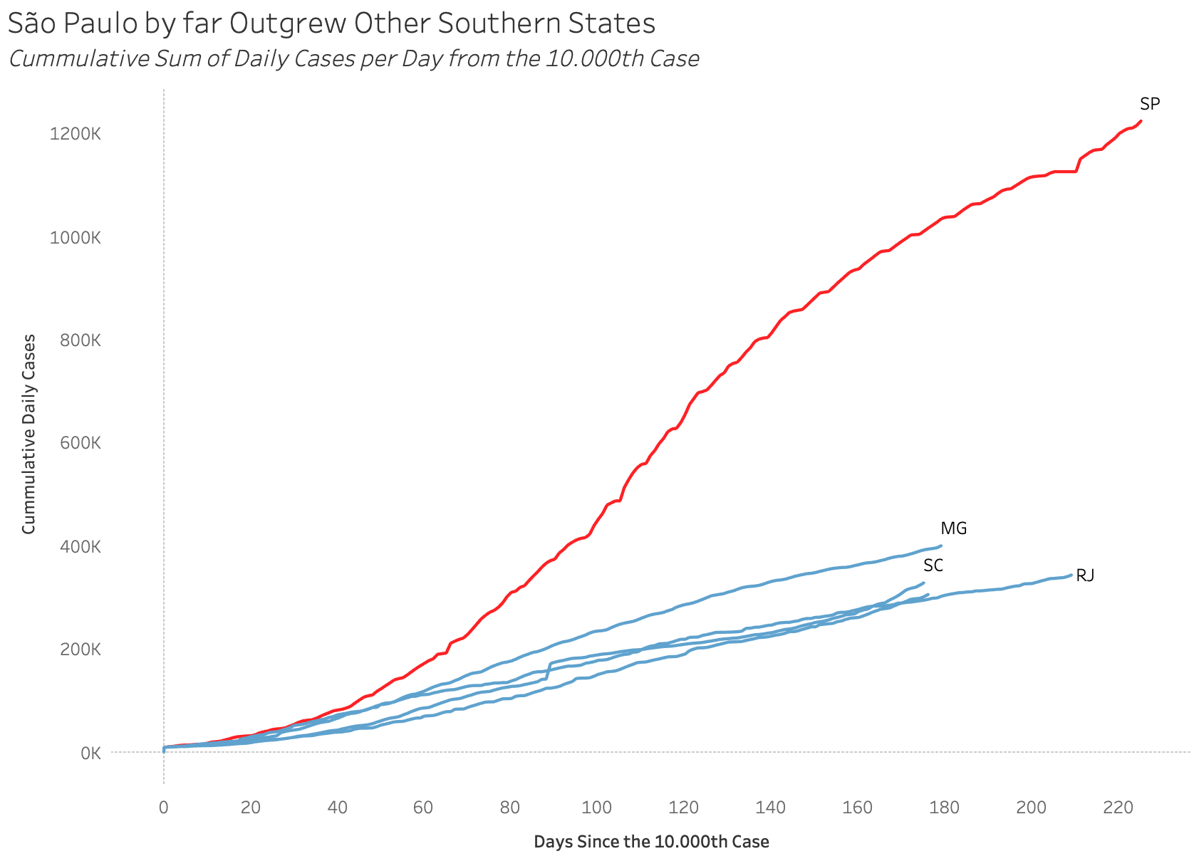
São Paulo outgrew others in this area

Slide 8
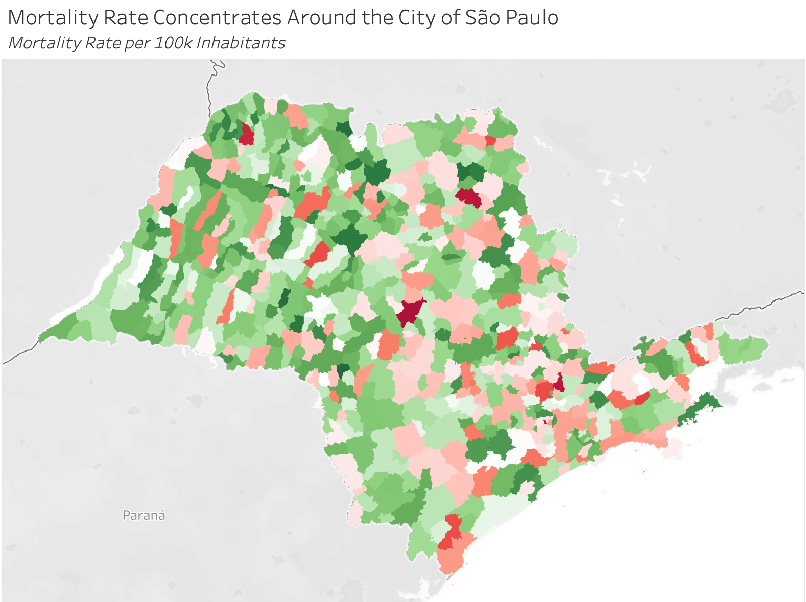
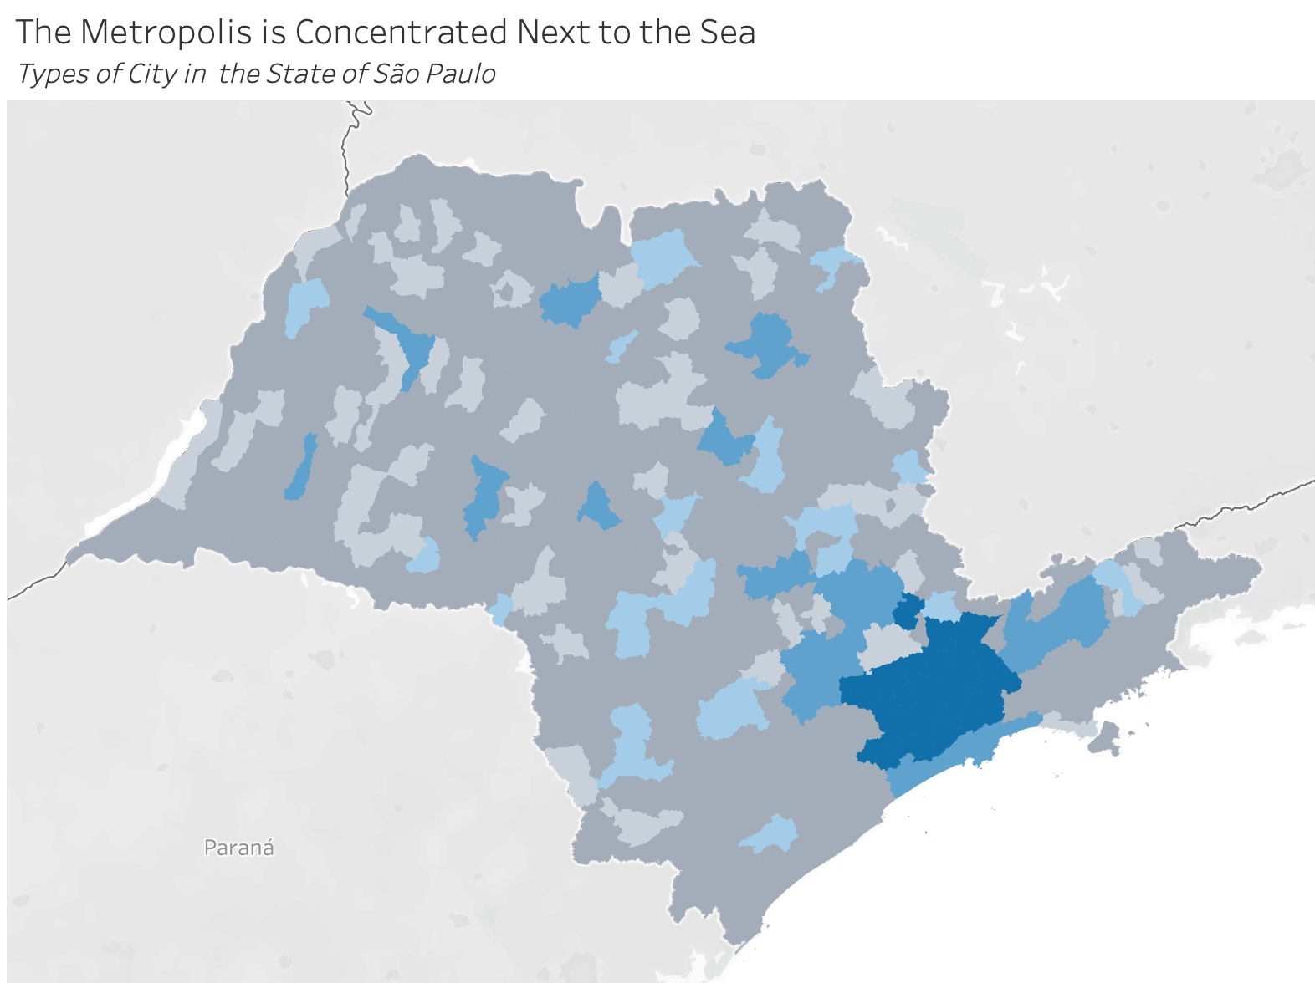
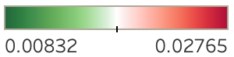
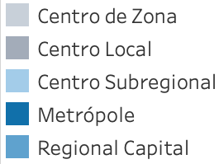
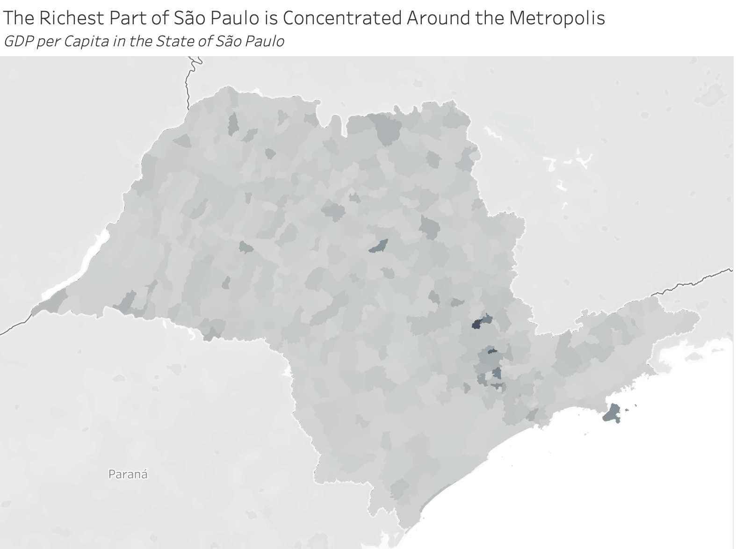
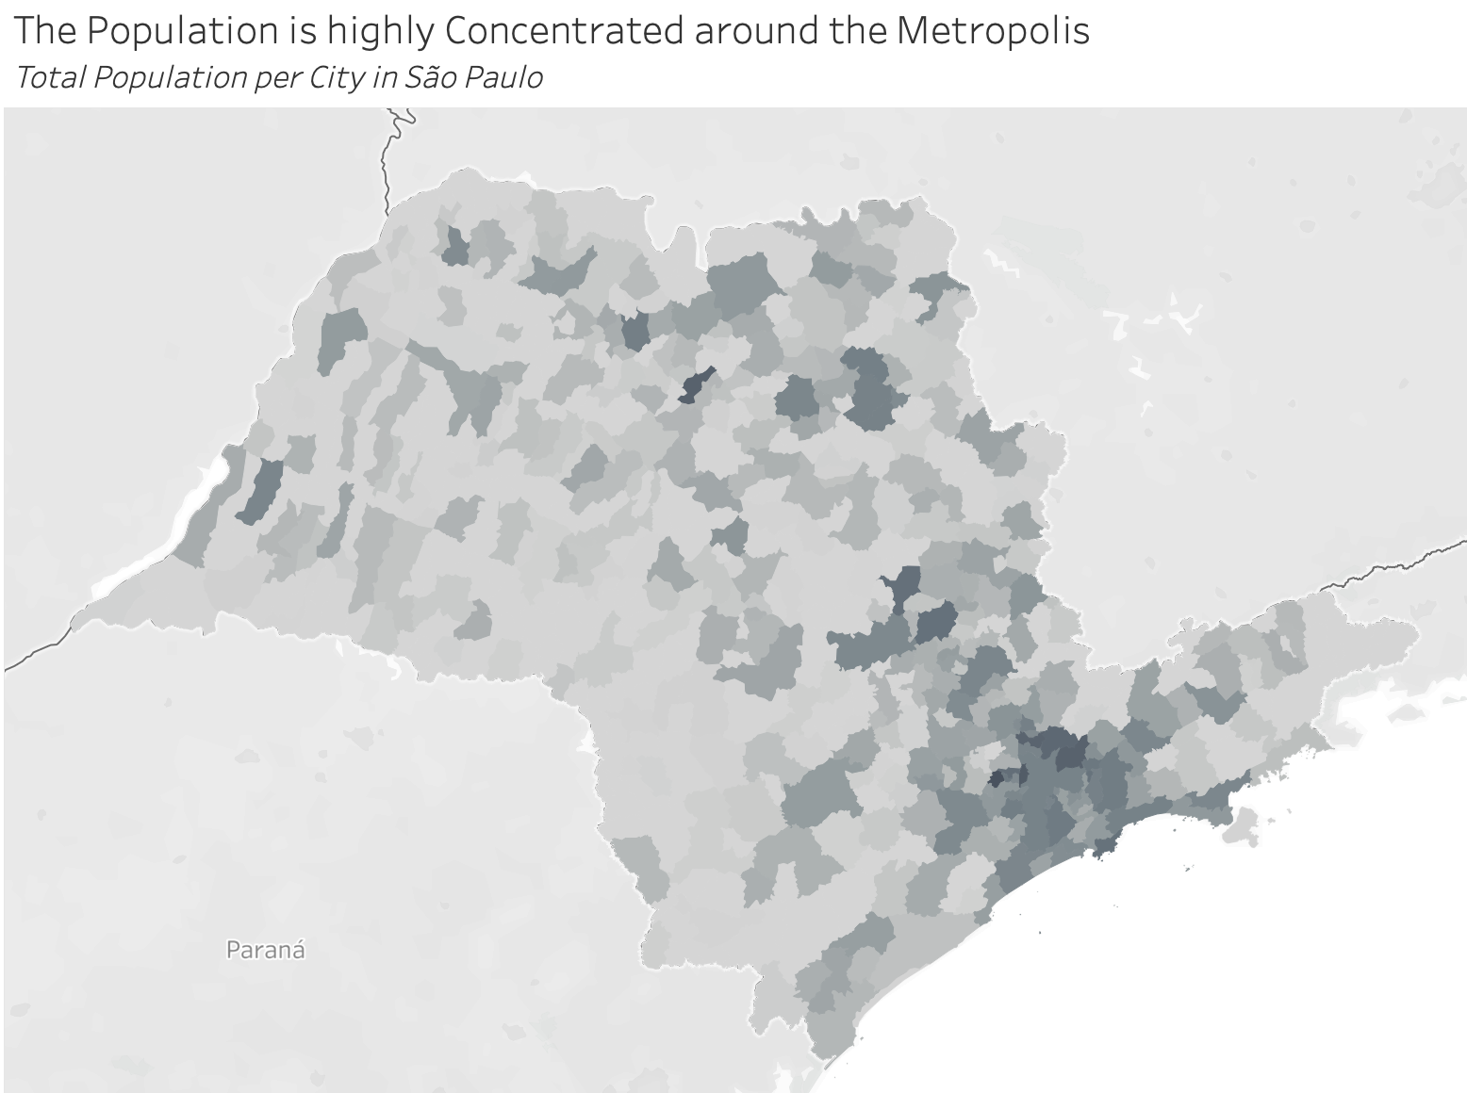
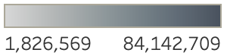
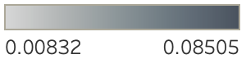
Investigating conditions in São Paulo
Mortality Rate
City Type
GDP per Capita
Population

Slide 9
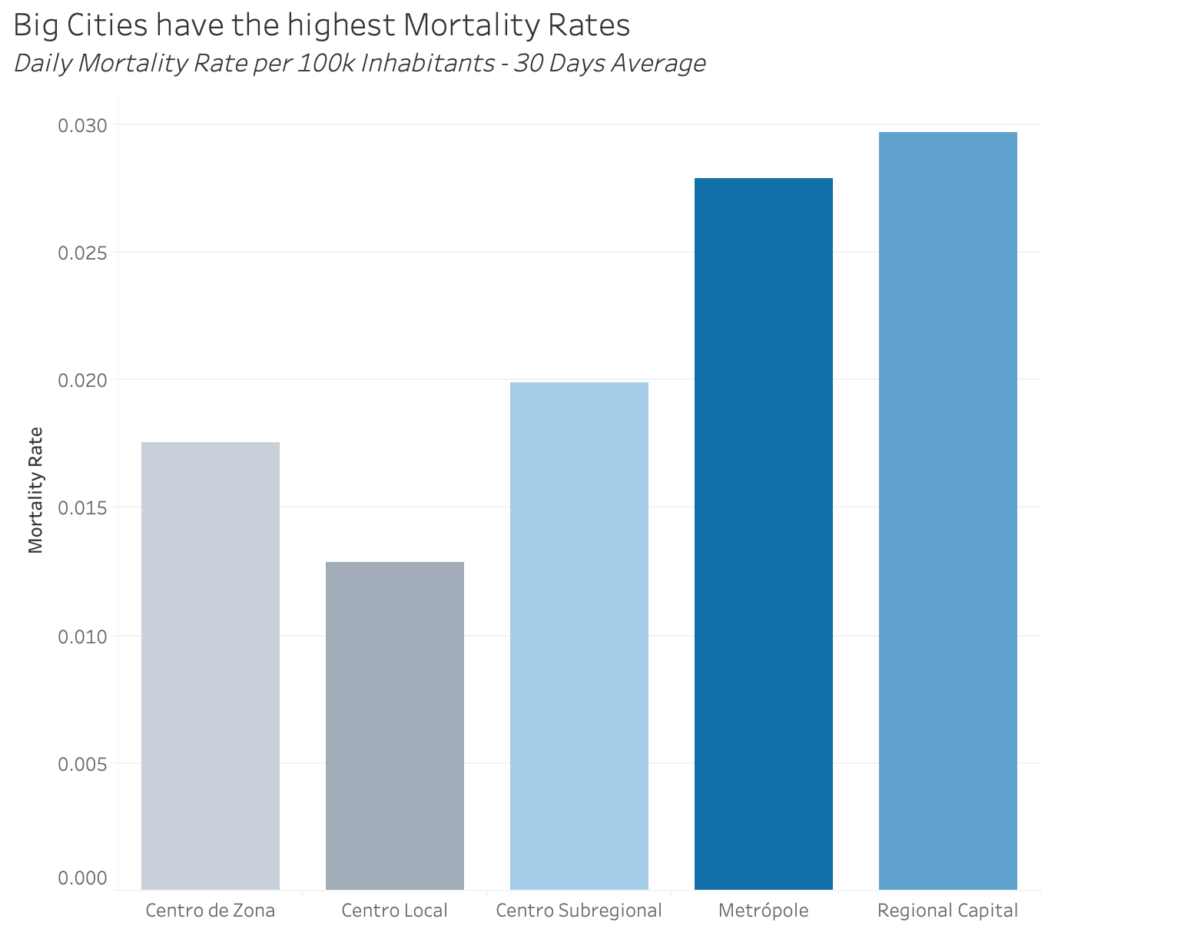
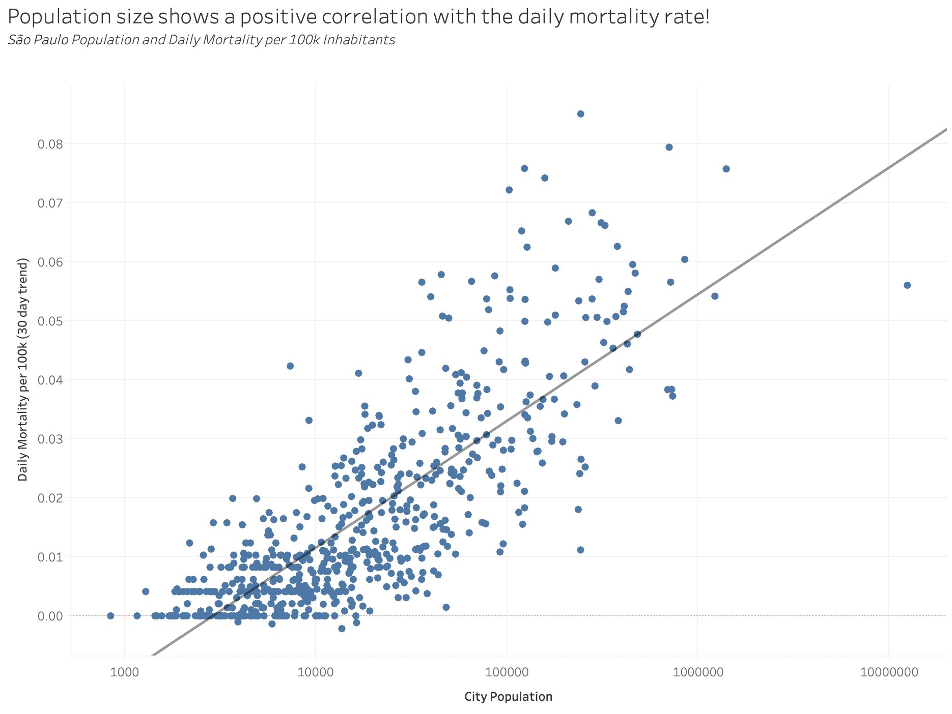
Population & City-type affect mortality

Slide 10
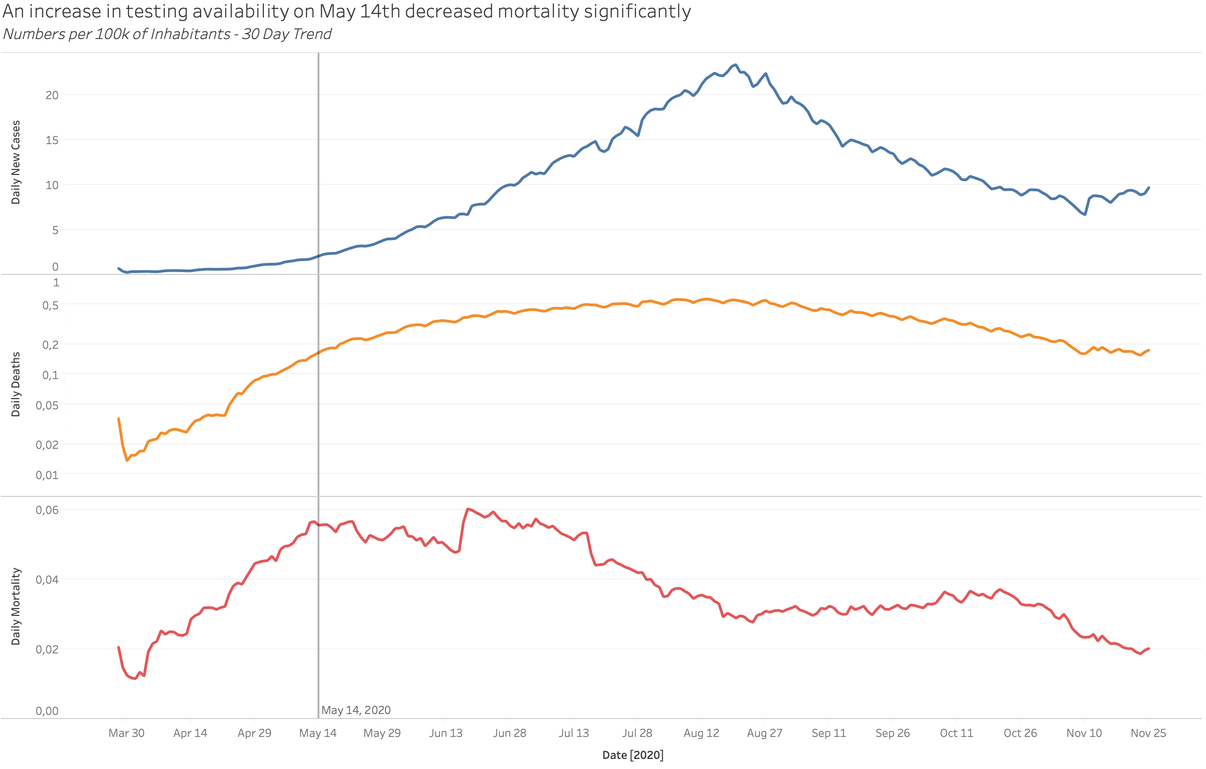
Playing the Numbers?
“SP will start mass testing for COVID-19 from the 15th of may”
– G1 (20/04/2020)
Notes:
https://g1.globo.com/sp/sao-paulo/noticia/2020/04/20/sp-tera-testagem-em-massa-para-coronavirus-a-partir-de-15-de-maio-segundo-vice-governador.ghtml

Slide 11
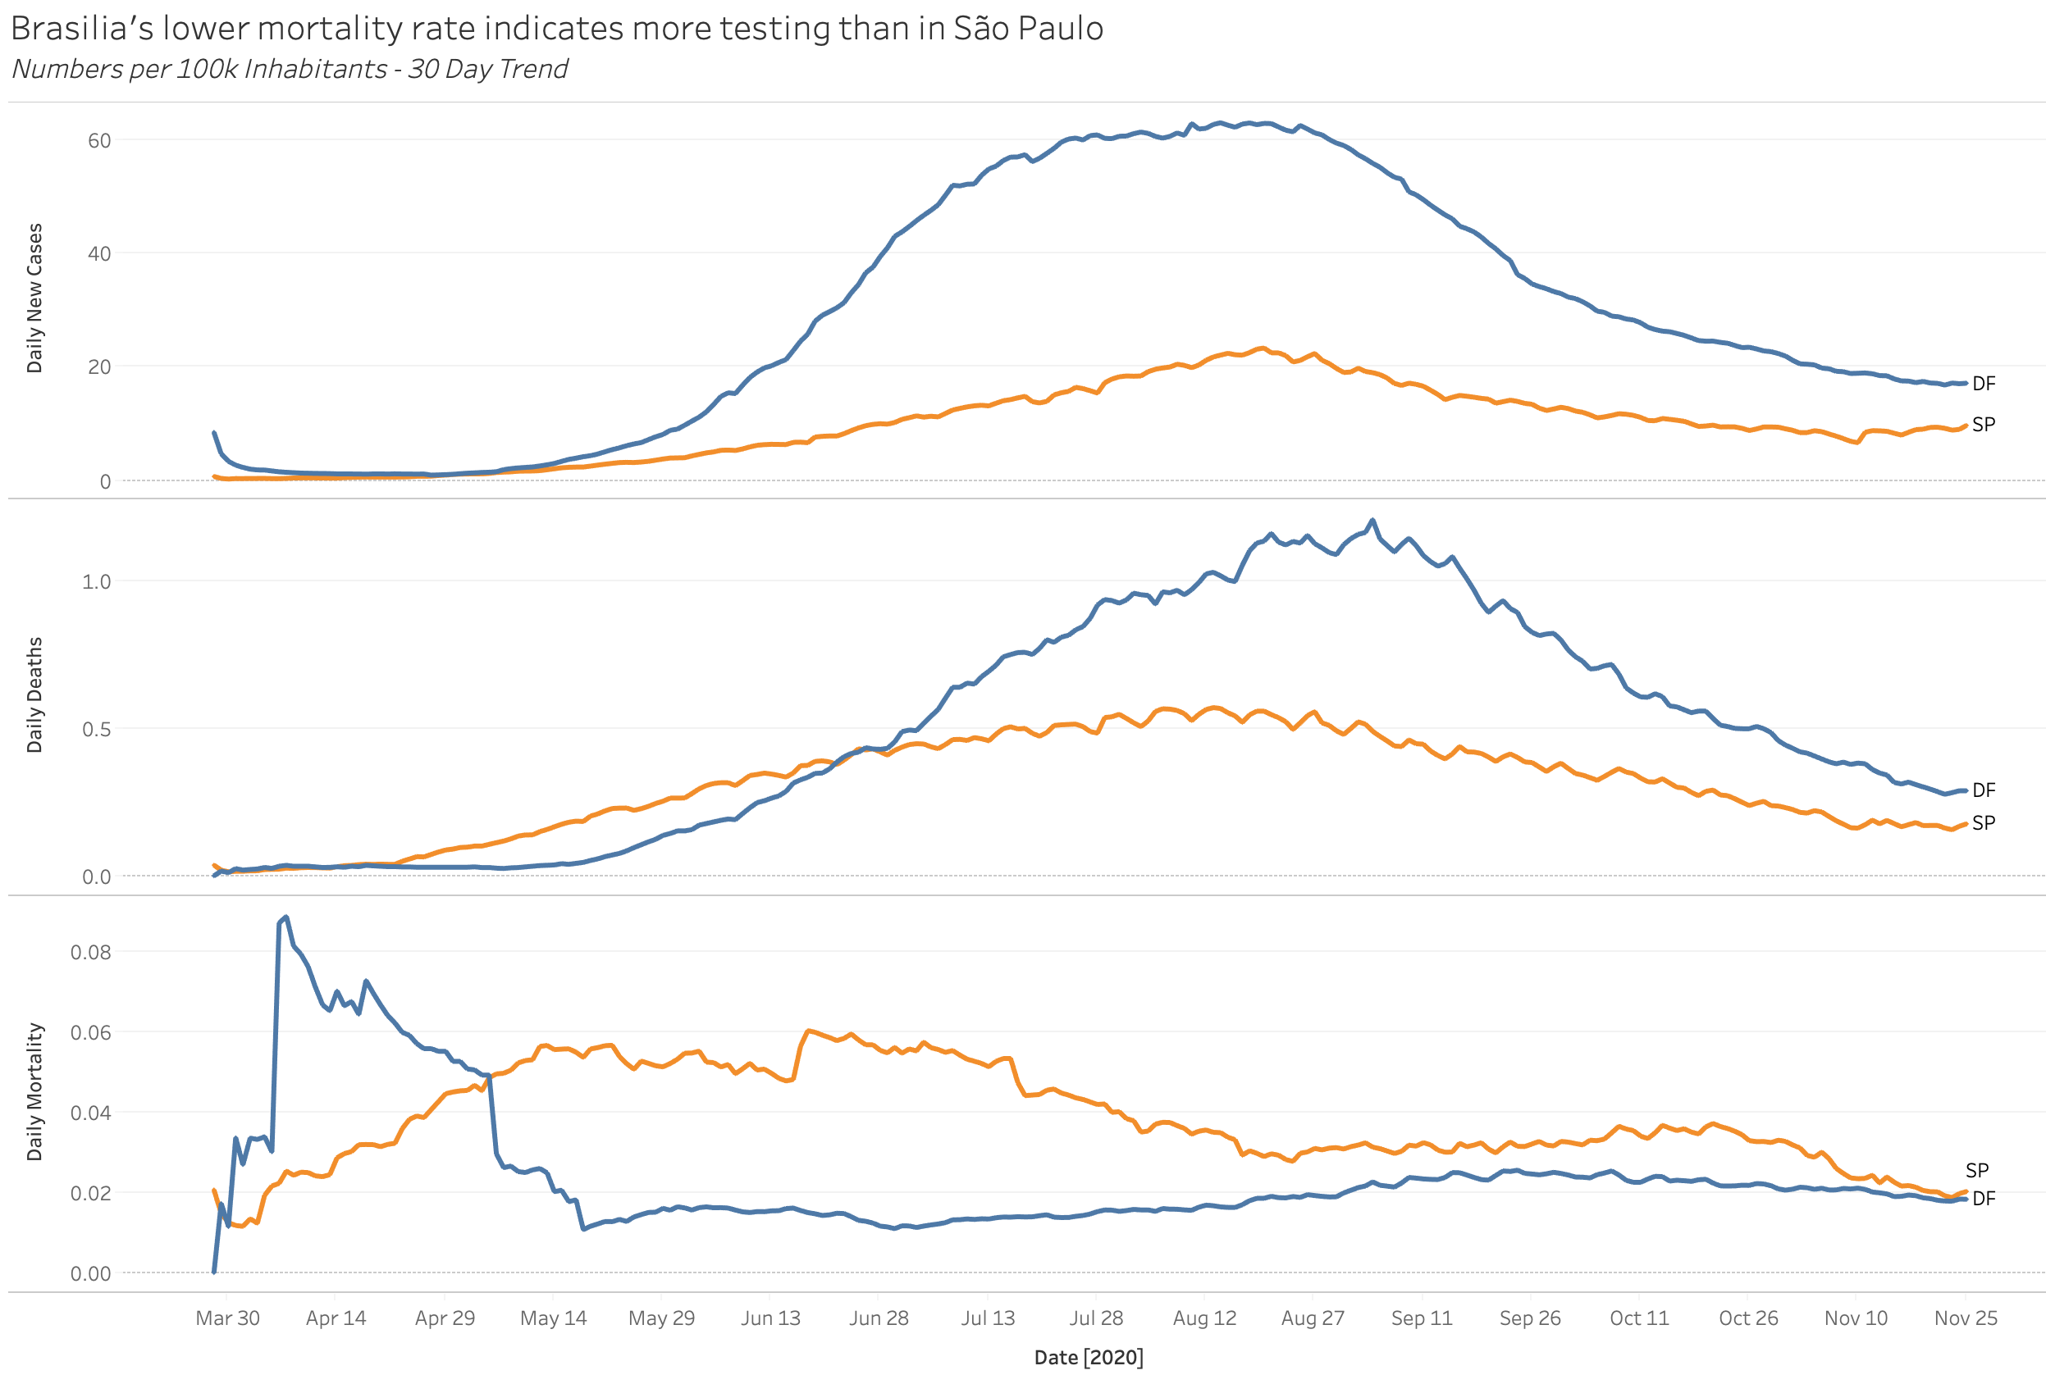
Preferential treatment for the capital?
“DF already tested 10% of the population while SP 1.31%” – GDF (18/06/2020)
Notes:
https://agenciabrasilia.df.gov.br/2020/06/18/df-ja-testou-10-da-populacao-para-covid-19/

Slide 12
Cases rising even after lockdown?
“SP passes 3M COVID-19 tests, with daily increase of 3000%”
– São Paulo gov (14/08/2020)
Notes:
https://www.saopaulo.sp.gov.br/ultimas-noticias/governo-de-sao-paulo-atualiza-informacoes-sobre-o-combate-ao-coronavirus-4/

Slide 13
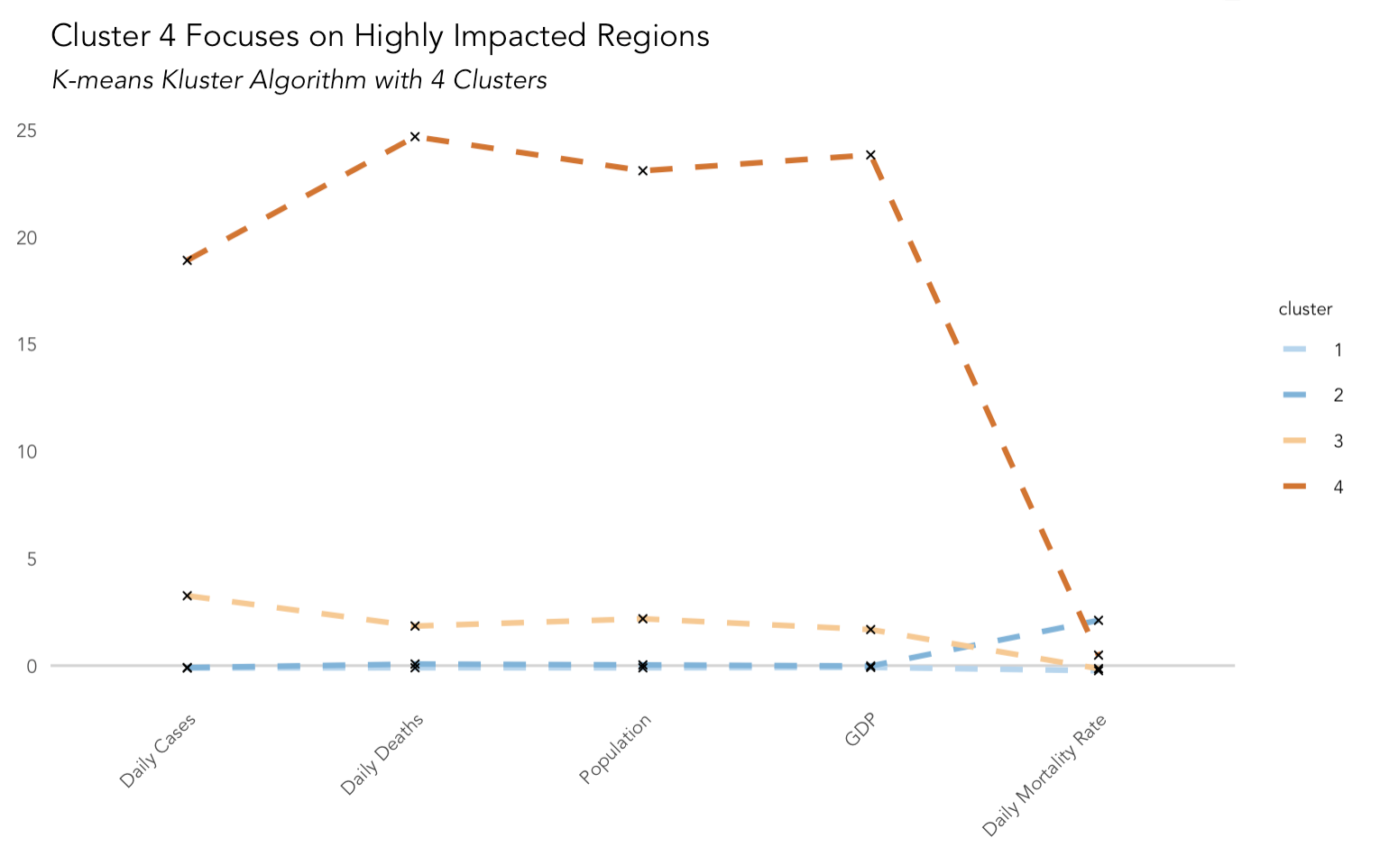
Clustering cases per city
Cluster

Slide 14
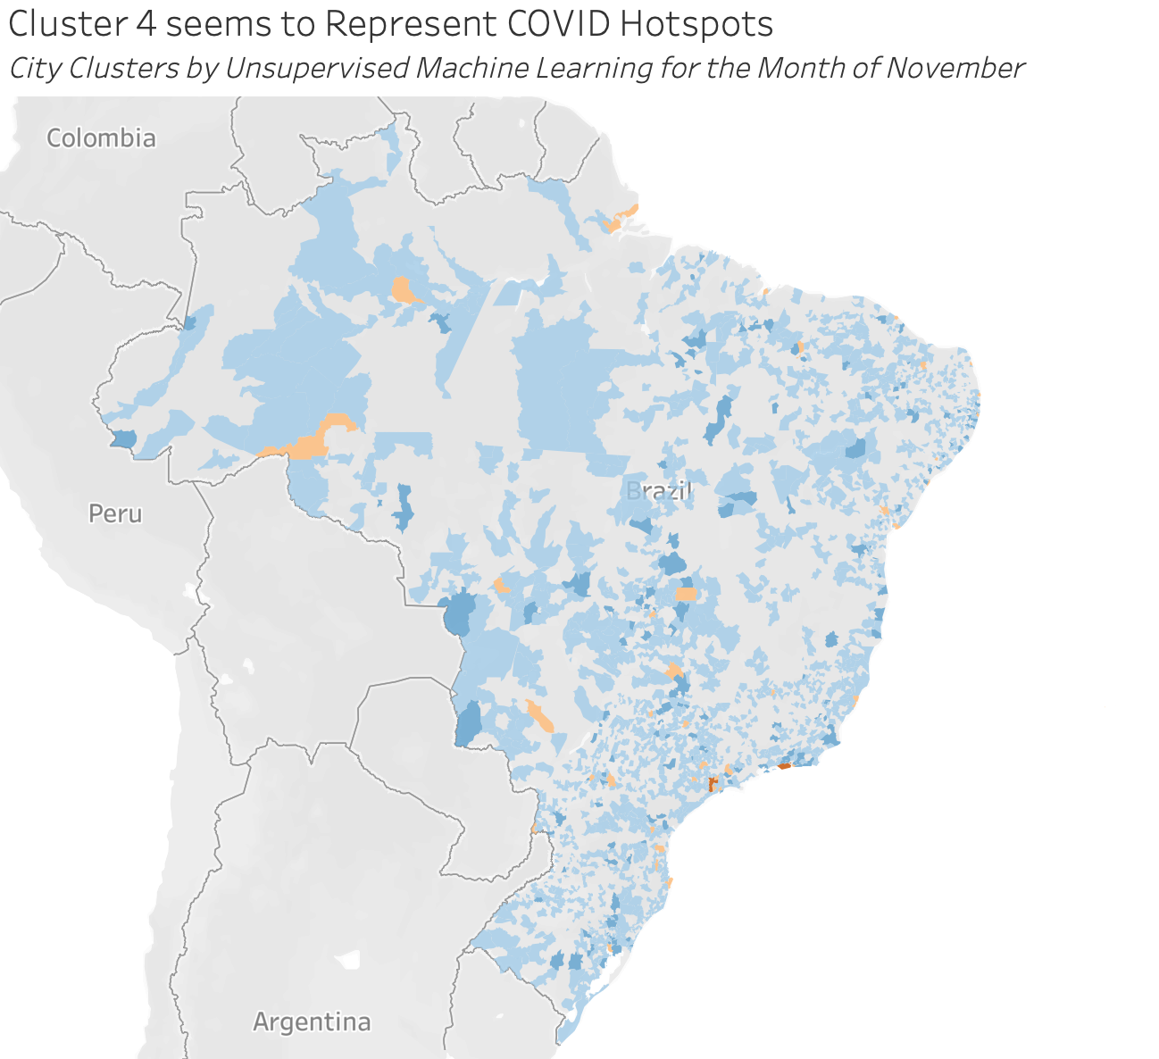
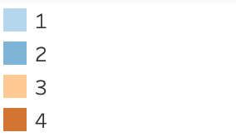
Clustering Results
Cluster
Avg. Daily Cases

Slide 15
Takeaways
City population and City type had a significant impact on the spread of the Virus.
We believe to have observed the impacts a large variability in testing availability across Brazilian cities had on mortality rates.
Our cluster identified two types of small / local cities, those with high and those with low cases

